Slide 1
Unplugged
윤명근
School of Software @ Kookmin University

Slide 2
목차
Counting
Sorting

Slide 3
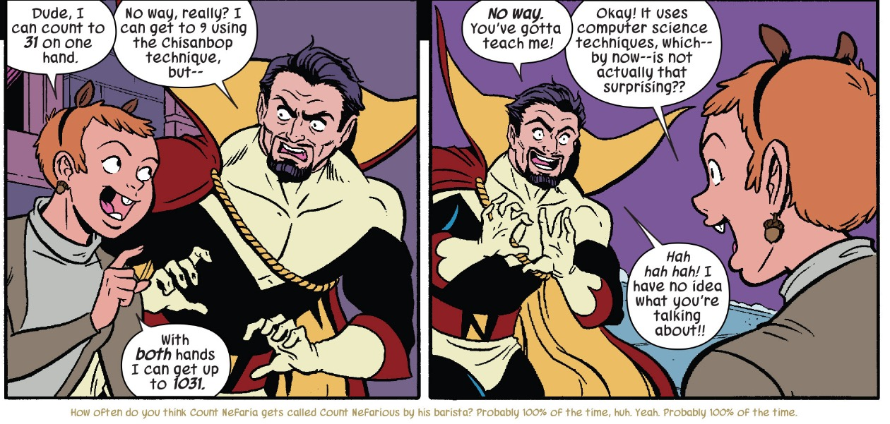
counting
한 손으로 0~31까지 세는 방법
http://www.waitwhatpodcast.com/tag/dc/

Slide 4
counting
아래 카드를 만들어서 직접 해보자.

Slide 5
counting
아래 카드를 만들어서 직접 해보자.
https://www.ncwit.org/resources/computer-science-box-unplug-your-curriculum-2018-update

Slide 6
counting
아래 카드를 만들어서 직접 해보자.
2진수, 8진수, 16진수
https://www.ncwit.org/resources/computer-science-box-unplug-your-curriculum-2018-update

Slide 7
Sorting
https://brilliant.org/wiki/sorting-algorithms/

Slide 8
Q & A
School of Software @ Kookmin University

